Slide 1
Secure Email
CS 465
Slides by Kent Seamons and Tim van der Horst
Last Updated: Nov 29, 2016

Slide 2
Goals
Be able to describe how secure email works to provide confidentiality, integrity, and authentication
Understand trust model differences
PGP
S/MIME
Gain experience using secure email

Slide 3
PGP (Pretty Good Privacy)
Designed by Phil Zimmerman
Originally designed as a human rights tool
Published for free on the Internet in 1991
Phil was the target of a three year criminal investigation
Where to get PGP?
http://www.philzimmermann.com/EN/findpgp/index.html
pgp.com
GnuPG (GPG)
In the 1990’s, one way to skirt federal export controls was to publish the source code in book form (this was allowed), ship the books to Europe, scan the source code using OCR technology to create the code. Laborious, but legal.
Trust model
Web of trust
Grass roots, bottom up

Slide 4
S/MIME
Secure Multipurpose Internet Mail Extension
Security extension to the MIME Internet email format
Trust model
Hierarchical
CAs that issue X.509 certificates
Top-down
Usually found in companies and government

Slide 5
Key Management
Recommended that you use a different public key for signing outgoing and receiving incoming encrypted email
PGP
Generate your own keys
You are responsible to distribute
In person or through key servers
Key signing parties!
S/MIME
Generate your own keys
Have your public key signed by a CA
Start sending signed email
Your public key is sent along with a signed message

Slide 6
How Secure Email is Sent
The following example is taken from a PGP description
Sign-then-encrypt
The way that both symmetric encryption and asymmetric encryption are used together is common to most secure messaging systems

Slide 7
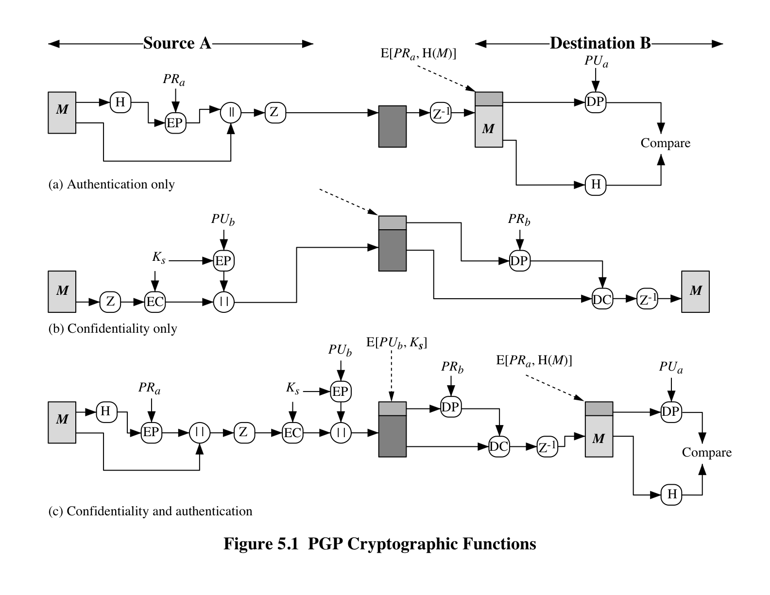

Slide 8
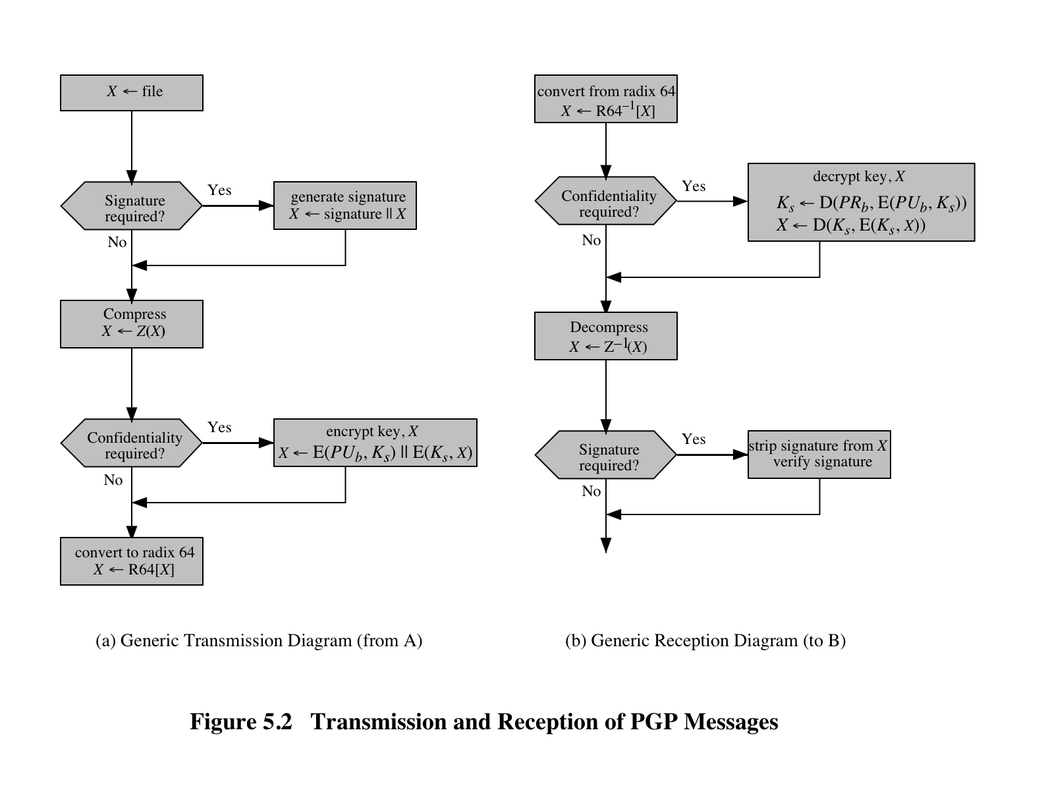

Slide 9
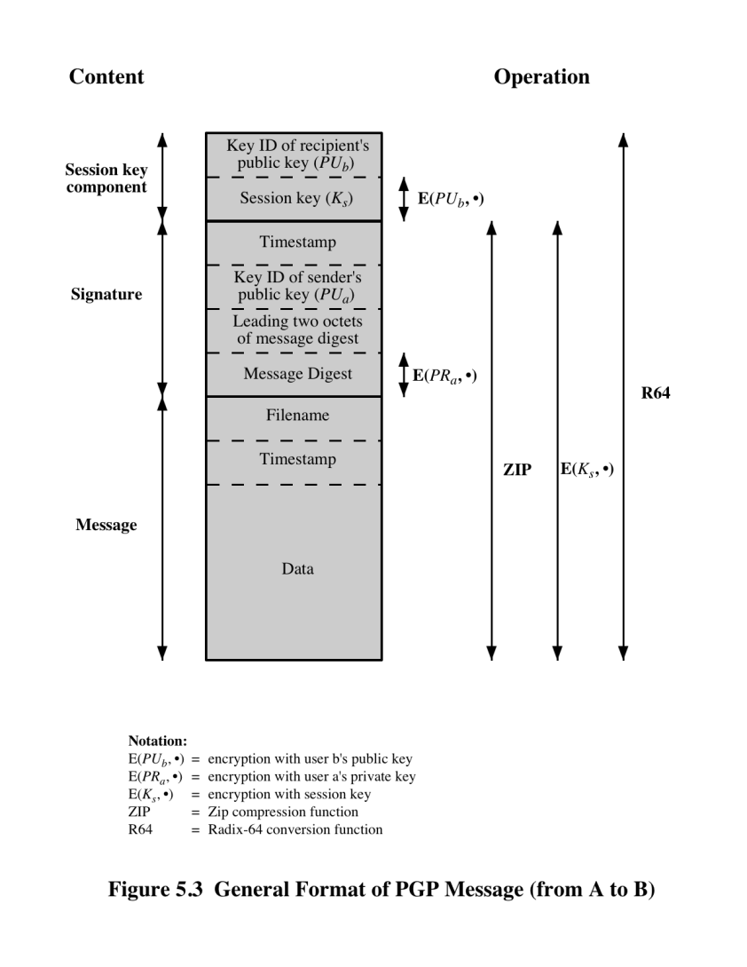

Slide 10
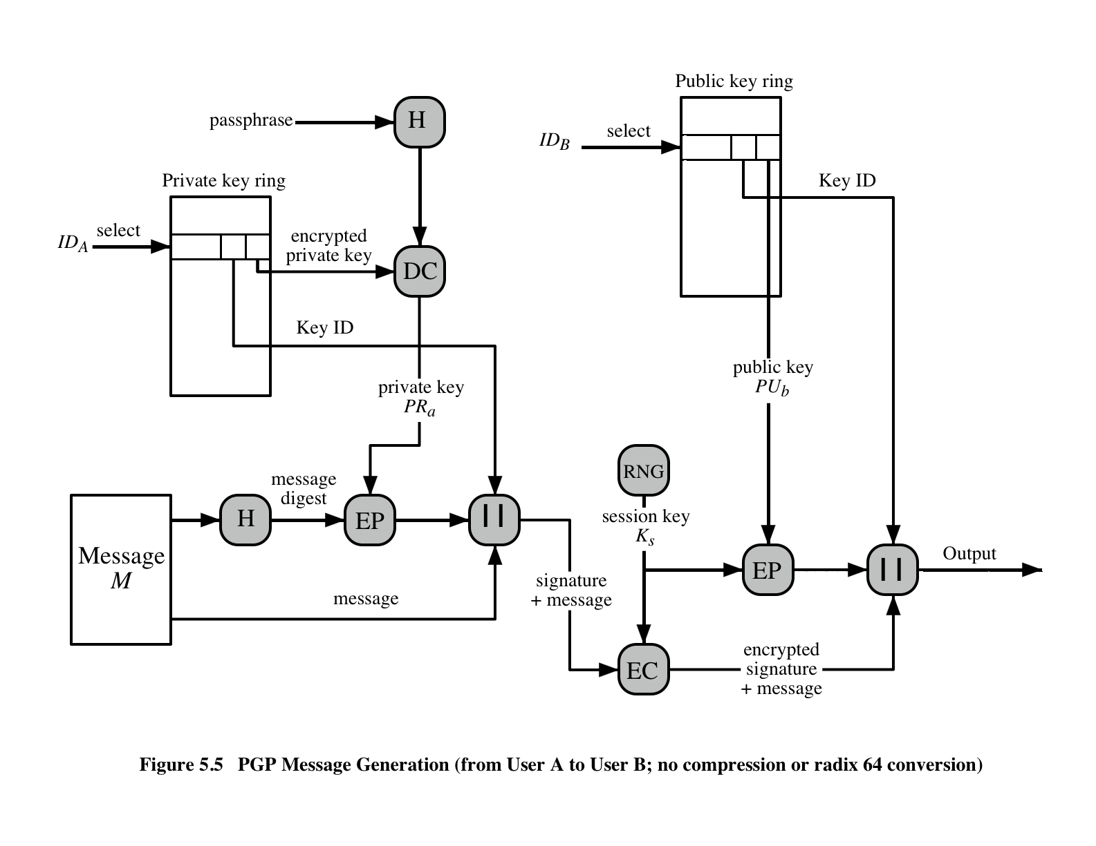

Slide 11
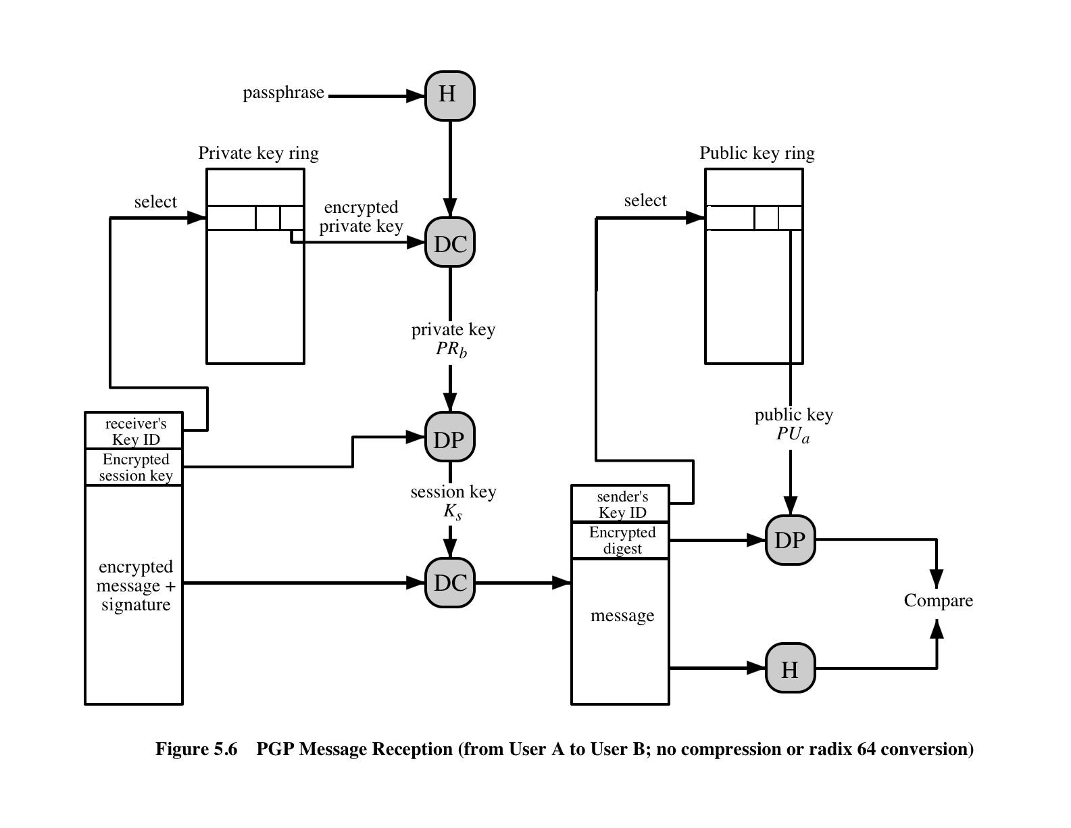

Slide 12
How Secure is our Email?
Until recently, most email was sent and received in the clear over the network
FireSheep prompted webmail providers to use SSL to protect connections.
Email is usually stored in the clear
Free email supported by ad revenue
Connections between providers is sometimes encrypted (STARTTLS)

Slide 13
Email Authenticity
DKIM (Domain Keys Identified Email)
Providers sign email sent from their domain
Public key published in DNS
Clients validate the signature (problematic)
Sender Policy Framework
Authorized email hosts published in DNS
Google visual indicators for email sent in the clear and not authenticated https://blog.google/products/gmail/making-email-safer-for-you-posted-by/

Slide 14
Why is Secure Email Not Used?
Usability challenges of key management
Chicken and egg problem
PGP history of usability studies that failed
Why Johnny Can’t Encrypt (1999)
Why Johnny Still Can’t Encrypt (2006)
Why Johnny Still, Still Can’t Encrypt (2015) – BYU
Schneier reacts - https://www.schneier.com/blog/archives/2015/11/testing_the_usa.html
Recent success with secure messaging apps supporting end-to-end encryption
Signal, WhatsApp, Facebook Messenger, Google Allo
Prevents passive attacks
Key validation is not done, so active attack may be possible.

