Slide 1
TLS
CS 465
Last Updated: Oct 31, 2017

Slide 2
Student Learning Goals
Understand the TLS handshake
Understand client/server authentication in TLS
RSA key exchange
DHE key exchange
Explain certificate ownership proofs in detail
What cryptographic primitives are used and why?
Understand session resumption
Understand the limitations of TLS

Slide 3
Genesis of TLS
SSLv1 (1994) Netscape unreleased
PCT (1995) Microsoft
SSLv2 (1994) Netscape First release
SSLv3 (1995) Netscape
STLP (1996) Microsoft
WTLS (1998) WAP Forum
TLS 1.0 (1997-1999) IETF (aka SSLv3.1)
TLS 1.1 (2006)
TLS 1.2 (2008)
Source: SSL and TLS, Rescorla

Slide 4
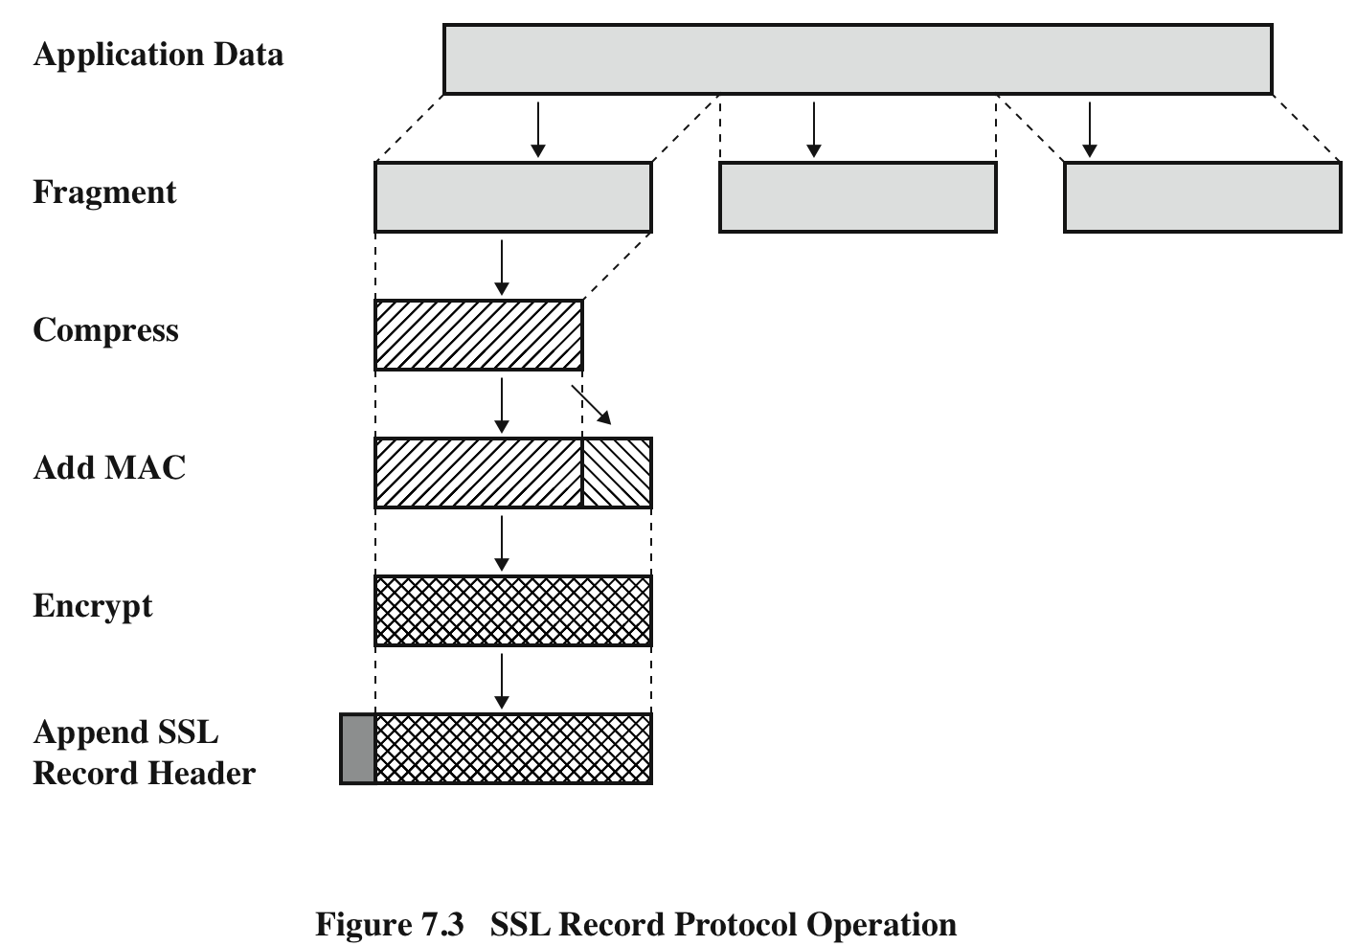
SSL Record Protocol Operation
SSL Record Protocol Operation
Source: Network Security Essentials (Stallings)

Slide 5
SSL Record Format
SSL Record Format
Source: Network Security Essentials (Stallings)

Slide 6
RSA Key Exchange Method
Client
Server
Client Hello [Random_client, Cipher Suites *, SessionID]
Server Hello [Random_server, Cipher Suites +, SessionID]
Server Certificate chain of X.509 Certs
Server Hello Done
Client Key Exchange [Pre-master secret encrypted with server public key]
Change Cipher Spec
Finished [Encrypted Running Hash]
Change Cipher Spec
Finished [Encrypted Running Hash]

Slide 7
RSA Key Exchange Method
Client
Mutual Authentication
Server
Client Hello [Random_client, Cipher Suites *, SessionID]
Server Hello [Random_server, Cipher Suites +, SessionID]
Server Certificate chain of X.509 Certs
Server Hello Done
Certificate
Client Key Exchange [Pre-master secret encrypted with server public key]
Certificate Verify
Change Cipher Spec
Finished [Encrypted Running Hash]
Change Cipher Spec
Finished [Encrypted Running Hash]

Slide 8
DHE Key Exchange Method
Client
Server
Client Hello [Random_client, Cipher Suites *, SessionID]
Server Hello [Random_server, Cipher Suites +, SessionID]
Server Certificate [chain of X.509 Certs]
Server Key Exchange [signed DH info]
Random_client, Random_server, g, p, server DH param
Server Hello Done
Client Key Exchange [client DH public param]
Change Cipher Spec
Finished [Encrypted Running Hash]
Change Cipher Spec
Finished [Encrypted Running Hash]

Slide 9
Key Material for TLS
RSA
Client generates pre-master secret
Sends to server encrypted with servers public key
DHE
DH shared key is the pre-master secret
Pre-master secret and random values used to compute master secret
Master secret and random values used to compute key block material
Key block contains 4 or 6 keys
Two keys for AES, 2 keys for MAC, 2 keys (IV) for block cipher mode if needed

Slide 10
Perfect Forward Secrecy
In vanilla RSA, the premaster secret is encrypted with the server’s public key
If the server’s private key is compromised all past and future sessions are also compromised
Majority of TLS uses vanilla RSA
Alternatives
Ephemeral Diffie-Hellman (DHE-RSA)
Elliptic curve variation is faster (ECDHE)

Slide 11
Forward Secrecy
Using an ephemeral key
Even if the server’s private key is later compromised, past sessions cannot be decrypted, even if captured and stored by a third party

Slide 12
TLS 1.3
https://blog.cloudflare.com/tls-1-3-overview-and-q-and-a/
Reduced round trips in the handshake
Certificates are encrypted
Quick session resumption

Slide 13
Review Questions
How many shared keys are derived between a client and a server that establish a TLS session?
How does the server prove ownership of its private key?
How does the client prove ownership of its private key when client authentication is (rarely) used?
What is the pre-master secret?
Who creates it?
How is it securely transmitted?
What is session resumption?
How does it differ from a regular SSL handshake?
When do the client and server start encrypting traffic using symmetric encryption?

Slide 14
Review Questions
How many shared keys are derived between a client and a server that establish a TLS session?
Each side generates 4-6 keys
How does the server prove ownership of its private key?
Implicitly by decrypting the pre-master secret and finishing handshake
How does the client prove ownership of its private key when client authentication is (rarely) used?
Send digital signature to the server
What is the pre-master secret?
Who creates it?
How is it securely transmitted?
What is session resumption?
How does it differ from a regular SSL handshake?
When do the client and server start encrypting traffic using symmetric encryption?
Finished message

Slide 15
Limitations/Issues
Certificate Authority system
TLS Proxies
TLS Inspection
Proxies, Middleboxes
Other approaches
Pinning (TOFU)
Notaries (Crowd)
DANE (DNS-based)

Slide 16
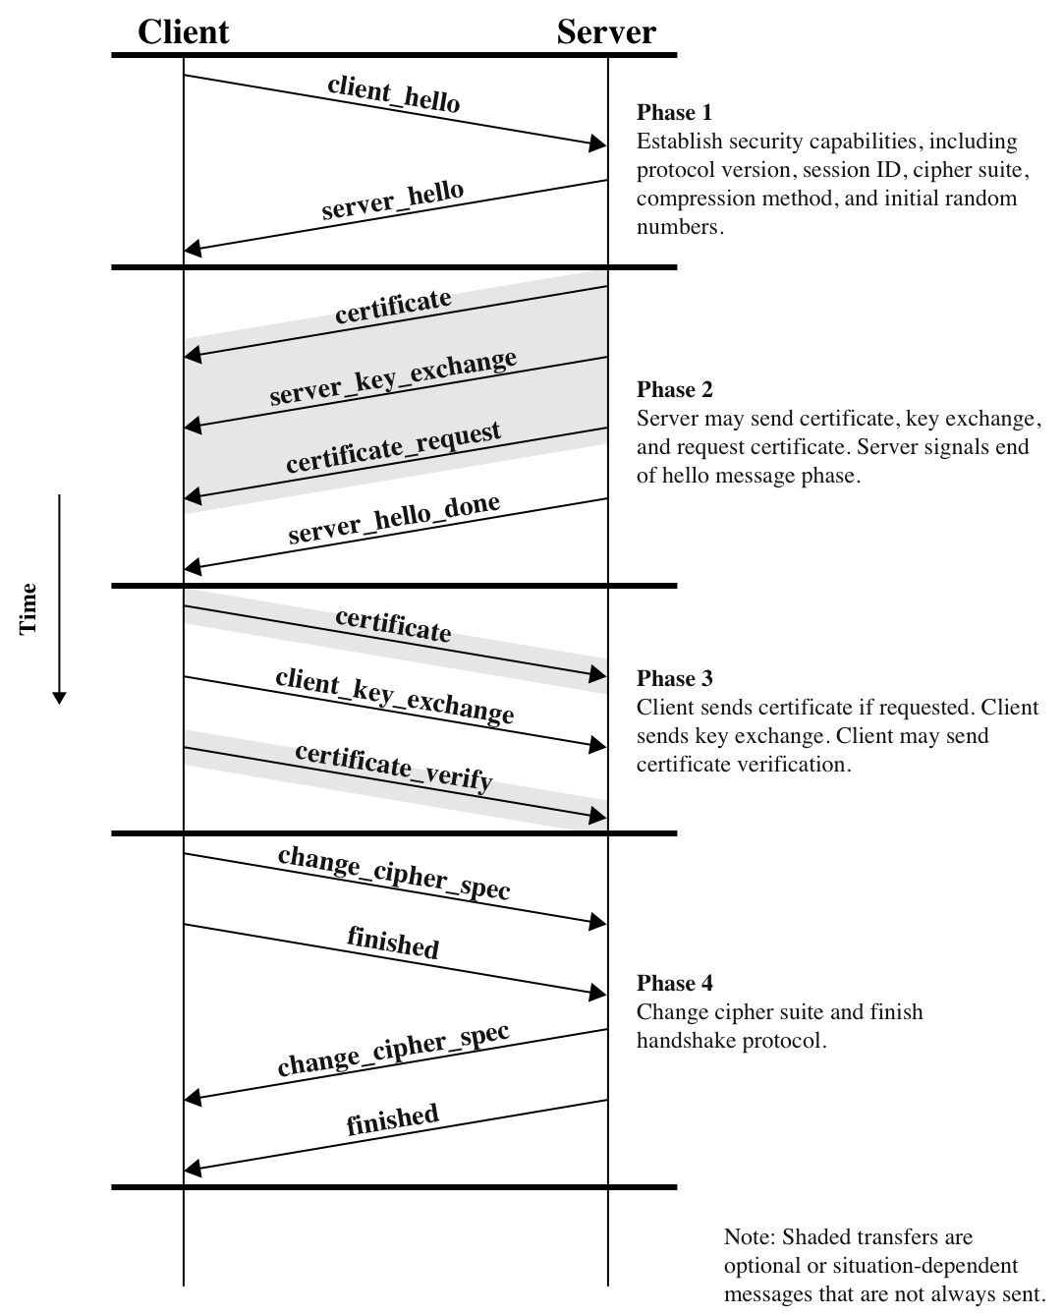
SSL Handshake
Source: Network Security Essentials (Stallings)

