Slide 1
Secure Email
CS 465
Slides by Kent Seamons and Tim van der Horst
Last Updated: Oct 8, 2012

Slide 2
Goals
Be able to describe how secure email works to provide confidentiality, integrity, and authentication
Understand the different in trust models between
PGP
S/MIME
Gain experience using secure email

Slide 3
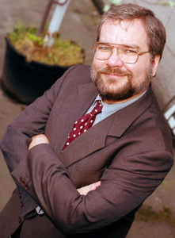
PGP Background
Designed by Phil Zimmerman
Originally designed as a human rights tool
Published for free on the Internet in 1991
Phil was the target of a three year criminal investigation
Where to get PGP?
http://www.philzimmermann.com/EN/findpgp/index.html
pgp.com
GnuPG (GPG)
In the 1990’s, one way to skirt federal export controls was to publish the source code in book form (this was allowed), ship the books to Europe, scan the source code using OCR technology to create the code. Laborious, but legal.
Trust model – web of trust

Slide 4
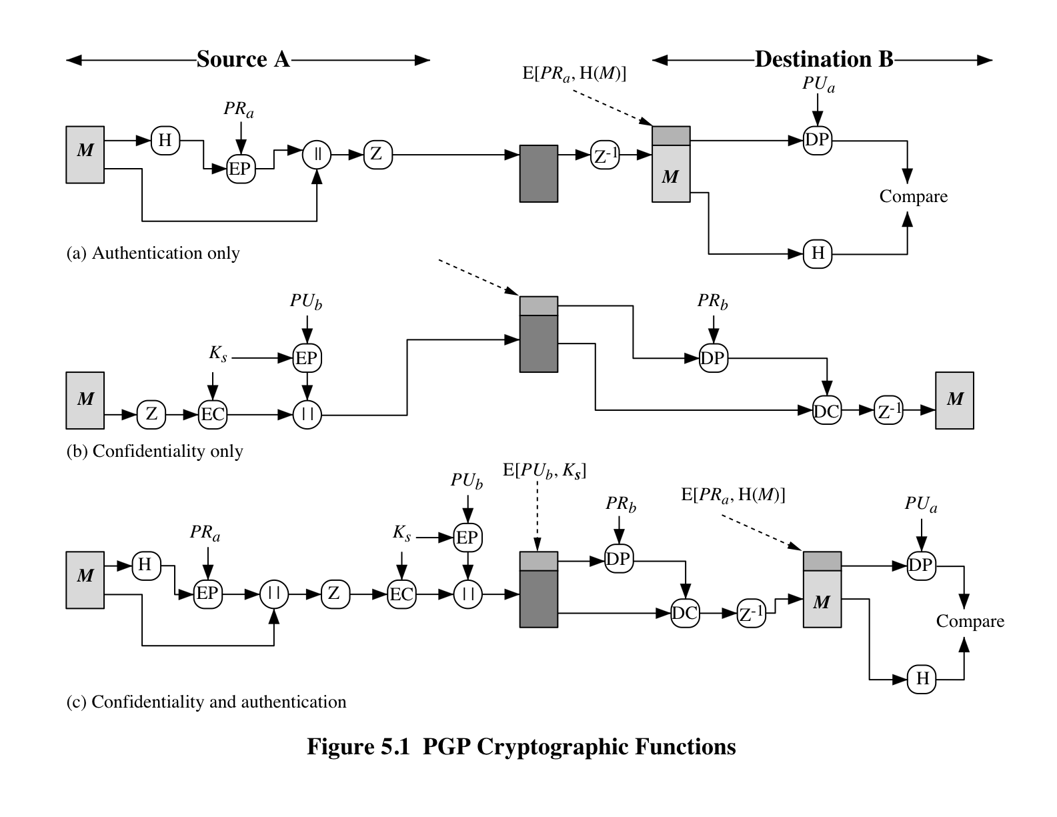

Slide 5
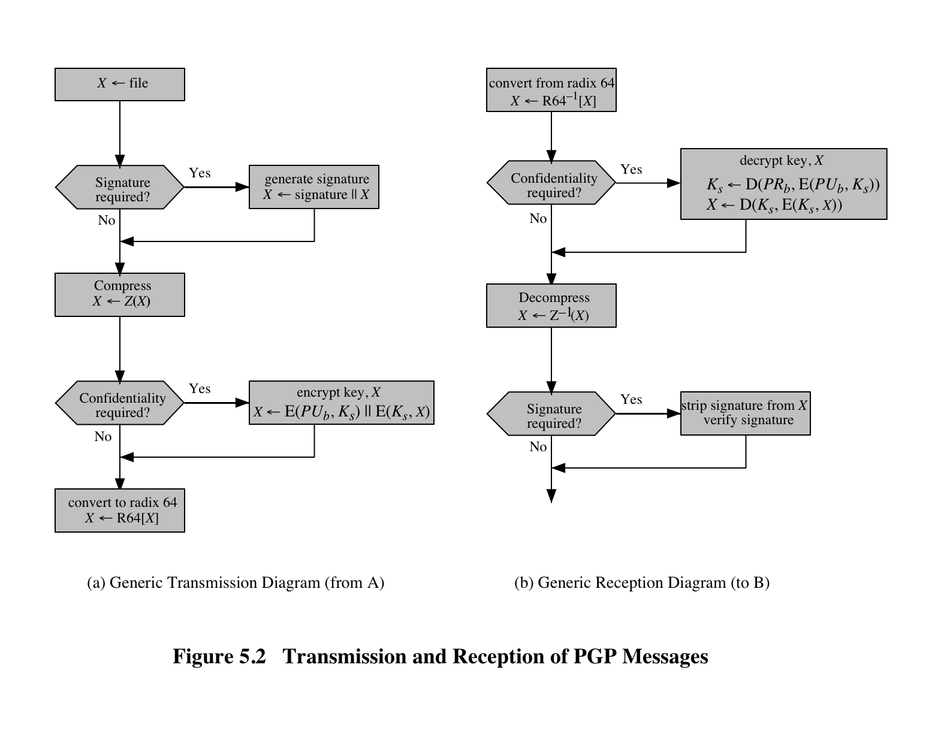

Slide 6
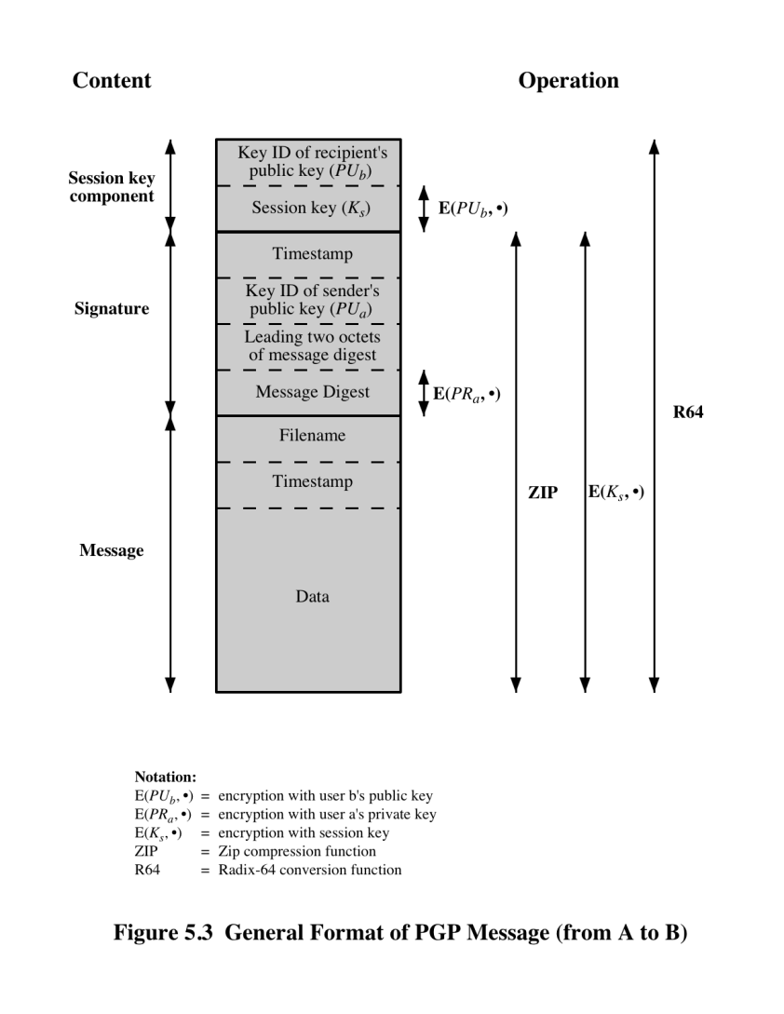

Slide 7
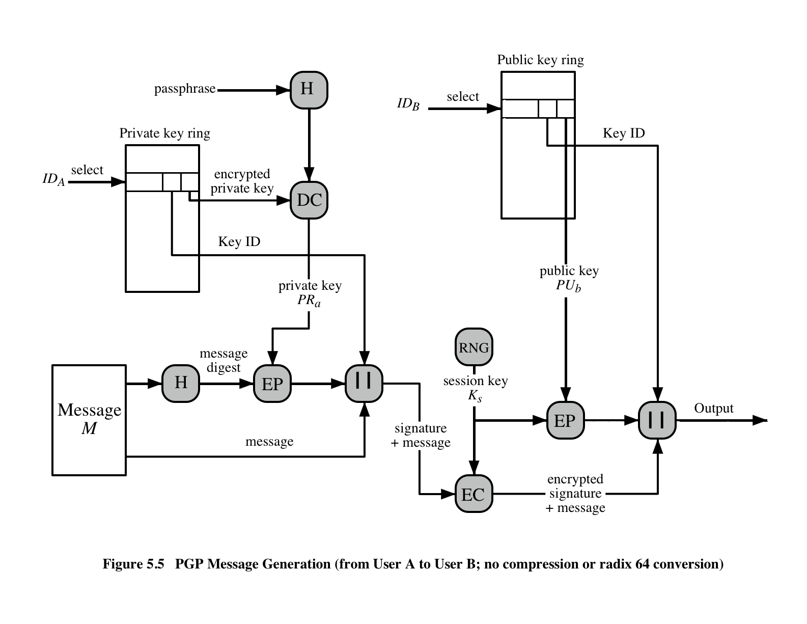

Slide 8
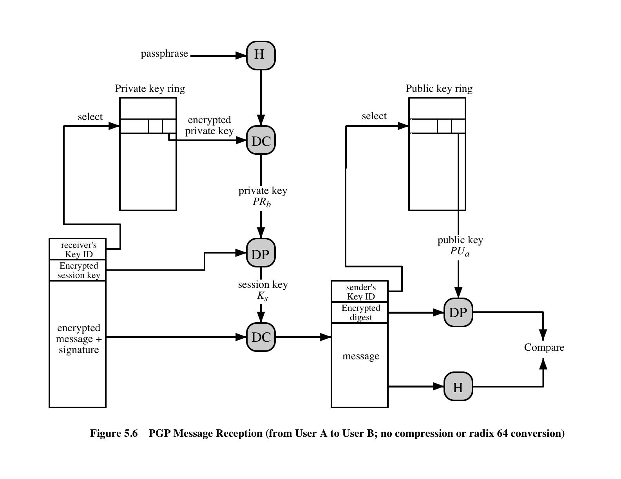

Slide 9
S/MIME
Secure Multipurpose Internet Mail Extension
Security extension to the MIME Internet email format
What is the trust model?
Hierarchical, top-down
X.509 certificates

