Slide 1
TLS
CS 465
Slides by Kent Seamons and Tim van der Horst
Last Updated: Nov 8, 2013

Slide 2
TLS

Slide 3
Student Learning Goals
Understand the TLS handshake
Understand client/server authentication in TLS
RSA key exchange
Explain certificate ownership proofs in detail
What cryptographic primitives are used and why?
Understand session resumption
Understand the limitations of TLS

Slide 4
Genesis of TLS
SSLv1 (1994) Netscape unreleased
PCT (1995) Microsoft
SSLv2 (1994) Netscape First release
SSLv3 (1995) Netscape
STLP (1996) Microsoft
WTLS (1998) WAP Forum
TLS 1.0 (1997-1999) IETF (aka SSLv3.1)
TLS 1.1 (2006)
TLS 1.2 (2008)
Source: SSL and TLS, Rescorla

Slide 5
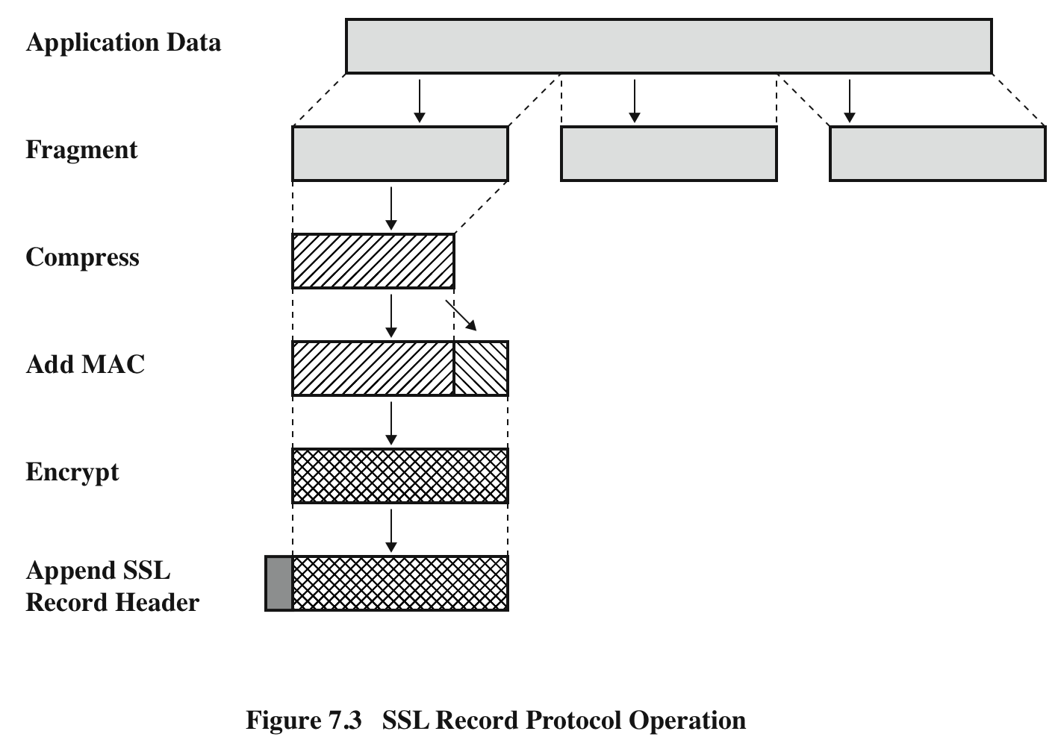
SSL Record Protocol Operation
SSL Record Protocol Operation
Source: Network Security Essentials (Stallings)

Slide 6
SSL Record Format
SSL Record Format
Source: Network Security Essentials (Stallings)

Slide 7
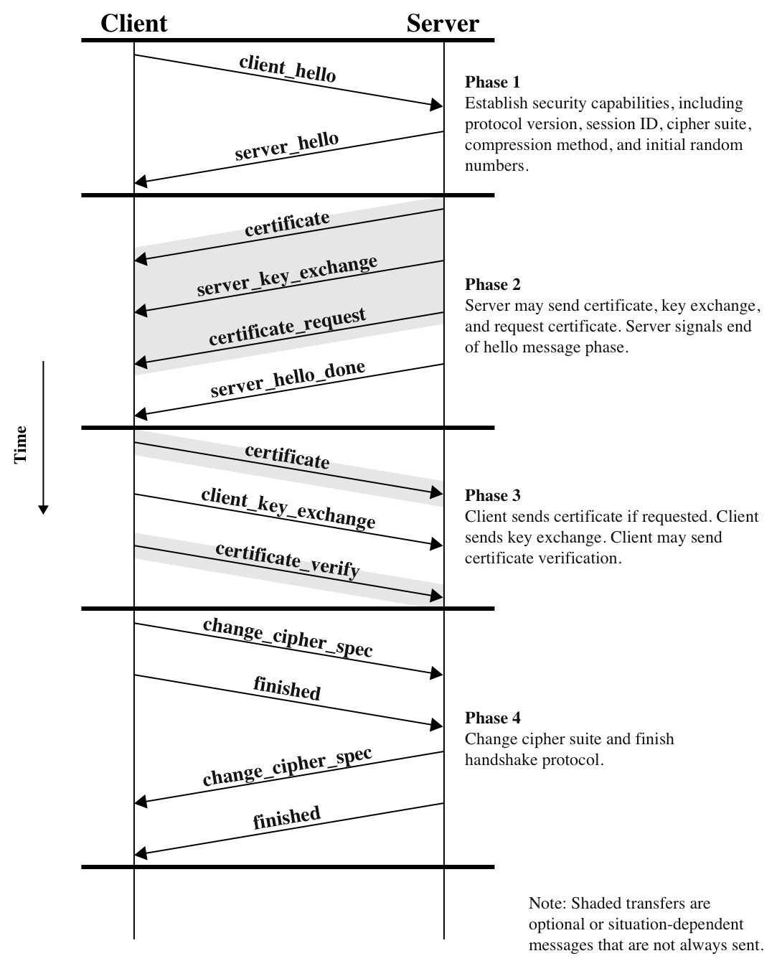
SSL Handshake
Source: Network Security Essentials (Stallings)

Slide 8
Perfect Forward Secrecy
In vanilla RSA, the premaster secret is encrypted with the server’s public key
If the server’s private key is compromised all past and future sessions are also compromised
Majority of TLS uses vanilla RSA
Alternatives
Ephemeral RSA
Authenticated Ephemeral Diffie-Hellman

Slide 9
Review Questions
How many shared keys are derived between a client and a server that establish a TLS session?
Each side generates 4-6 keys
How does the server prove ownership of its private key?
Implicitly by decrypting the pre-master secret and finishing handshake
How does the client prove ownership of its private key when client authentication is (rarely) used?
Send digital signature to the server
What is the pre-master secret?
Who creates it?
How is it securely transmitted?
What is session resumption?
How does it differ from a regular SSL handshake?
When do the client and server start encrypting traffic using symmetric encryption?
Finished message

